Slide 1
Edge Overview Series
Fundamental Concepts and Keywords

Slide 2



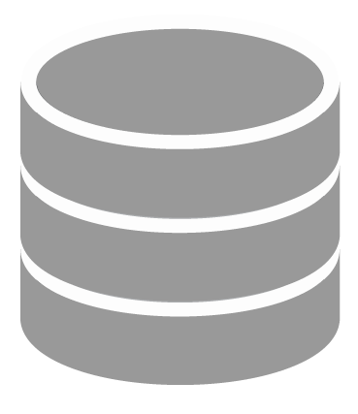
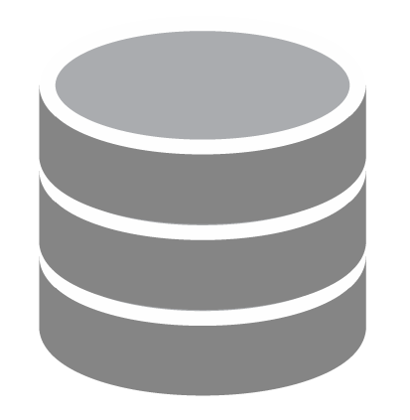



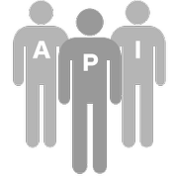




Concepts in a nutshell
Apigee
Edge
Organization
Mobile
Point of Sale
ESB, SOA,
App Servers,
Databases
Developers
Applications
API Team
Environment
Partner
Environment
Web
Environment

Slide 3





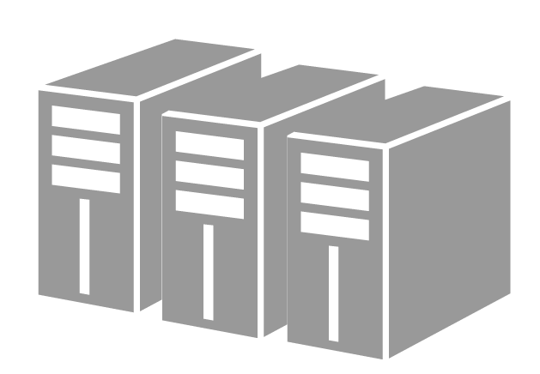
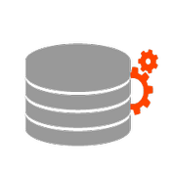


API Proxies and Policies
Environment
Proxy
ESB, SOA,
App Servers,
Databases
Policy
Policy
Policy
Applications
Caches
Key-Value Storage
Backend- as-a- Service
Analytics

Slide 4
Key Terms
An Organization is a collection of users, APIs and other resources.
An Environment is a subset of APIs in an organization that are in a given deployment state
Default environments: Test and Prod
An API Proxy is a set of configurable logic that handles API requests.
Flows (sometimes called resources) represent a specific request type within an API proxy - usually qualified by verb and path, but often by other request parameters as well.
Policies (also known as Flow steps) are bits of logic that can be executed during the course of processing a request
Policies can be applied to all resources in a proxy or only to select resources
Policies can be conditionally executed

Slide 5
Developers and Apps
Developers are the internal or external partners that create applications that use your API products
can be internal or external, and generally represent individuals
can be grouped into Companies
Developers are associated with Applications, which are developer-written programs that use APIs
can also be included in Companies
Applications (and Flows) can be grouped into Products for exposure to Application Developers
Application Developers are restricted by Products
NOTE: Companies, Company App Family, Company Developers can be configured using API. For configuring the above using UI, the org needs to enable monetization and some customization in the Developer Portal

Slide 6
API Security
Product
API Proxy 1
Consumer Key
Apps
API Proxy 2
Developer
API Proxy 3
Consumer Keys are:
assigned to an application when it is created
linked to a product when the product is associated with an application
API Products are:
collections of API resources, combined with a service plan and presented to developers as a bundle
the central mechanism for authorization and access control
NOTE: Consumer Key is also known as Client ID and API Key

Slide 7
Security for Edge Users
Permissions define create/read/update/delete access to resources
Roles identify a collection of permissions that can be assigned to a user
Predefined roles assign common permissions to key Edge resources
Organization Administrator
Administrator of an organization
Responsible for mainly user management but has super access to everything
Business User
API Program Manager
Responsible for success of API program and developer management, KPIs
Operations Administrator
API Operation Manager
Responsible for production and test deployment, troubleshooting
User
API Developer
Responsible for development of API proxy, policy management, troubleshooting etc.

Slide 8
API Proxy and Target Endpoints
Define an API as a series of resources that access a given target system.
Client-side interfaces can be accessed using either HTTP or HTTPS
Targets can be accessed using either HTTP or HTTPS, using either one-way SSL or two-way SSL with mutual authentication
REST and SOAP targets supported
“First match” selection: define a set of resource criteria matching incoming requests, and the first match found controls request execution
Resource matching on path nodes, query parameters, HTTP verbs and other types of conditions
Determine target service for requests using either static or dynamic routing with route rules defined in the proxy endpoint

Slide 9
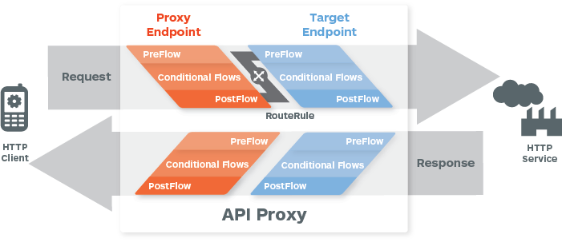
API Proxy Flows
Notes:
Flows allow you to define API resources.
Conditionally execute policies across all flows (resources) or only for specific resources.
Add policies that execute either before or after backend API request.

Slide 10
The Power of Policies
Traffic management policies | Mediation policies | Security policies | Extension policies
Traffic management policies let you configure cache, control traffic quotas and spikes, set concurrent rate limits, and so on. | Mediation policies let you perform message transformation, parsing, and validation, as well as raise faults and alerts. | Security policies let you control access to your APIs with OAuth, API key validation, and other threat protection features. | Extension policies let you provide custom policy functionality, with support for such features as service callout, message data collection, and calling Java, JavaScript, and Python behavior you have created.
Cache policies Concurrent Rate Limit policy Quota policy Reset Quota policy Spike Arrest policy | Access Entity policy Assign Message policy Extract Variables policy JSON to XML policy Key Value Map Operations policy Raise Fault policy SOAP Message Validation policy XML to JSON policy XSL Transform policy | Access Control policy Basic Authentication policy JSON Threat Protection policy LDAP policy *† OAuth v2.0 policies OAuth v1.0a policy Regular Expression Protection policy SAML Assertion policies Verify API Key policy XML Threat Protection policy | Java Callout policy * JavaScript policy Message Logging policy Python Script policy * Service Callout policy Statistics Collector policy * Cloud Enterprise only † On-Premises installation only
‹#›

Slide 11



Processing Pipeline
API Services
App
Backend
Enforce security
Validate request
Transform parameters and payload
Translate between developer-friendly APIs and backend systems
Build orchestration and optimization via node.js

Slide 12
Variables and Conditions
Variables allow you to store data for use during policy execution
Create using the Assign Message policy or from JavaScript/Java policies
Edge provides an extensive set of predefined variables covering areas such as:
System (date/time, hostname, etc.)
Configuration (organization/environment/application name, proxy base path, etc.)
Request and response (client IP address, query and form parameters, headers, request body, target hostname, timing data, etc.)
Policy (variables specific to the individual policy, such as rate limit info)
OAuth 1.0a and 2.0 (information related to access tokens, etc.)
Conditions allow you to control when a policy gets executed and which of a number of resource definitions is selected for processing
Compare path nodes, HTTP verbs, headers, query parameters, form parameters or variables with each other

Slide 13
Controlling Edge using Management APIs
Create, manage and delete just about anything:
API proxies
Policies
Developers and companies
Apps, app families and app keys
API products
Environments
Export and import entities
Manage users within org

Slide 14
What does it mean to “develop with Edge Platform”?
Determine the best organization and environment configuration for your needs
Identify members of the API team that need Edge access
Identify the authorization needs for the members
Design and implement mechanisms for registering/approving Developers / Apps, providing access. to documentation and other resources
Produce general guidelines for grouping your APIs into Products
Produce general guidelines for grouping your backend resources into Proxy Bundles
Identify deployment, Management and Monitoring strategies
Create API design, testing, access control and source code management guidelines
Design and document your Proxies identifying common policy flow or common proxies
Define test cases that verify the functionality, performance and load-bearing capacity of your APIs
Define process and procedure for moving proxy bundles between environments
Implement, Test and Deploy your APIs
Monitor the adoption and operation of your APIs

Slide 15
Lab 01 - Getting Setup
Steps
Using a web browser Navigate to https://login.apigee.com/login
If you have an apigee account, login
If you do not have an apigee account, select “sign up”
Fill out form and select create account
Activate Account by selecting link in email
Could take 5 – 10 minutes
Under API Management select the “launch” or “activate” button
Welcome to Edge!!
Notes:
Script:
Now we are going to get everyone setup with a free Apigee Account in the cloud, these free environments are a great way to explore Apigee’s api management products. Now lets follow the steps to create yourself a what we call a free org.

Slide 16
THANK YOU

